Slide 1
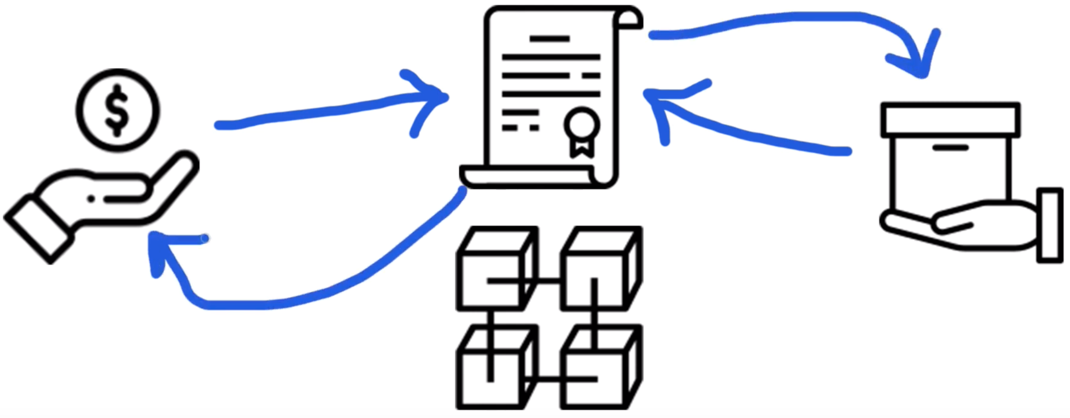
We Going To see What we have Build?

Slide 2
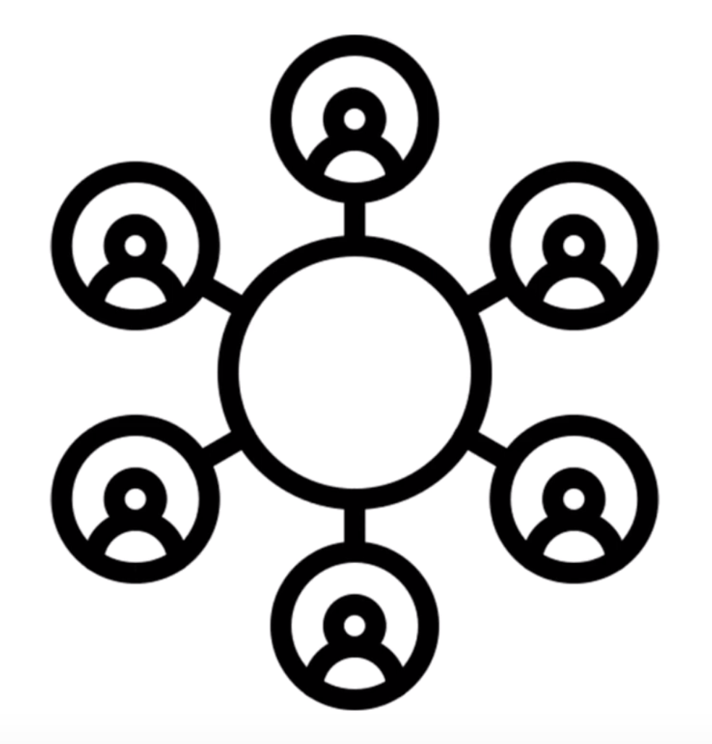
Block Chain

Slide 3
Blockchain in a few ways
One giant world-wide computer
A network
A database

Slide 4

So how do you connect to blockchain and use it?

Slide 5
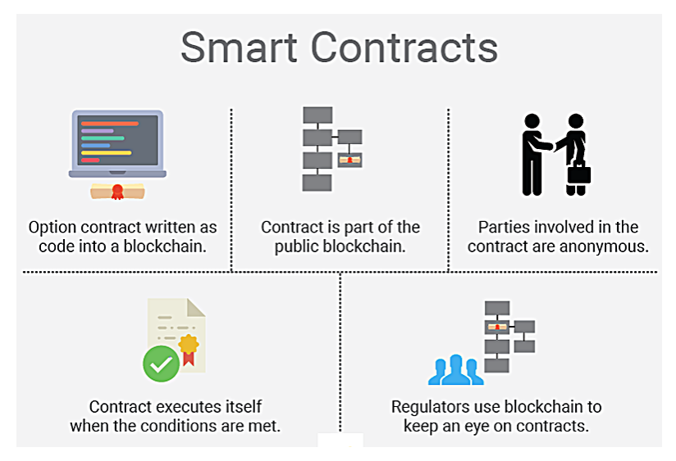
What Is A Smart Contract?

Slide 6
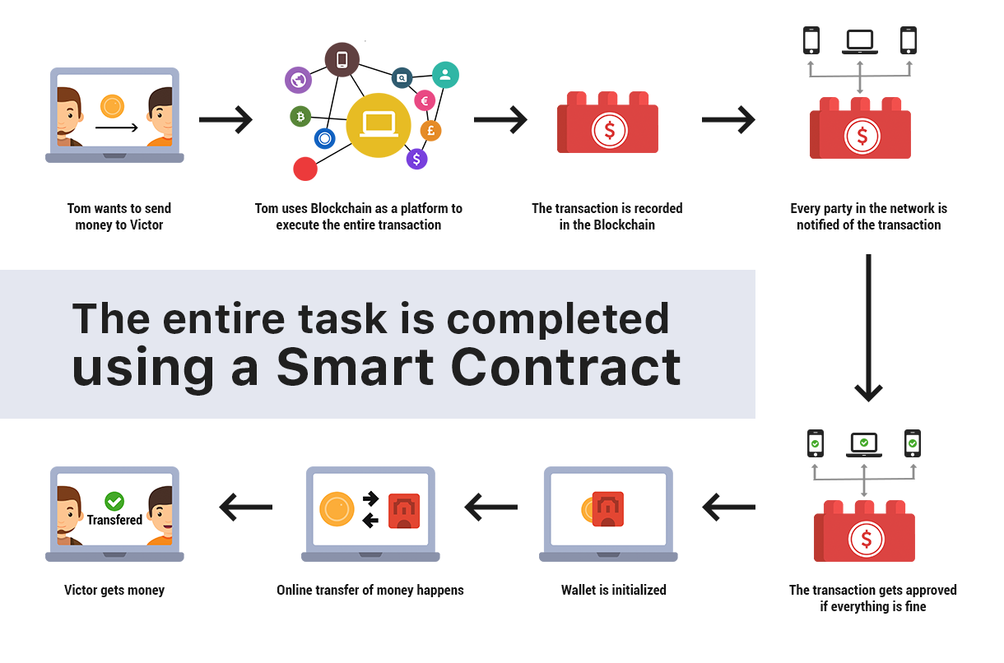
Example

Slide 7

How Does A Smart Contract Work In This Project?

Slide 8
Next let's look at the truffle-config.js file: require('babel-register'); require('babel-polyfill'); module.exports = { networks: { development: { host: "127.0.0.1", port: 7545, network_id: "*" // Match any network id }, }, contracts_directory: './src/contracts/', contracts_build_directory: './src/abis/', compilers: { solc: { optimizer: { enabled: true, runs: 200 } } } }

Slide 9
Create a new file for the smart contract tests like this:
> touch test/Marketplace.test.js
Inside this file, use the following code:
const Marketplace = artifacts.require('./Marketplace.sol')
contract('Marketplace', (accounts) => {
let marketplace
before(async () => {
marketplace = await Marketplace.deployed()
})

